Slide 1

NCR Ride Booking Analytics: Driving Insights Through Data
JERIN.P.AZEEZ

Slide 2

Introduction
Ride-booking platforms generate large volumes of data related to bookings, customers, drivers, vehicles, payments, and trip performance.
This project uses Power BI to transform ride-booking data into meaningful visual insights.
The analysis focuses on understanding:
  Booking trends and performance
  Booking status distribution
  Payment preferences
  Vehicle performance
  Customer and driver cancellations
  Ride distance
  Customer and driver ratings
Objective:
To build an interactive analytics dashboard that helps identify important patterns and performance indicators in ride-booking operations.

Slide 3
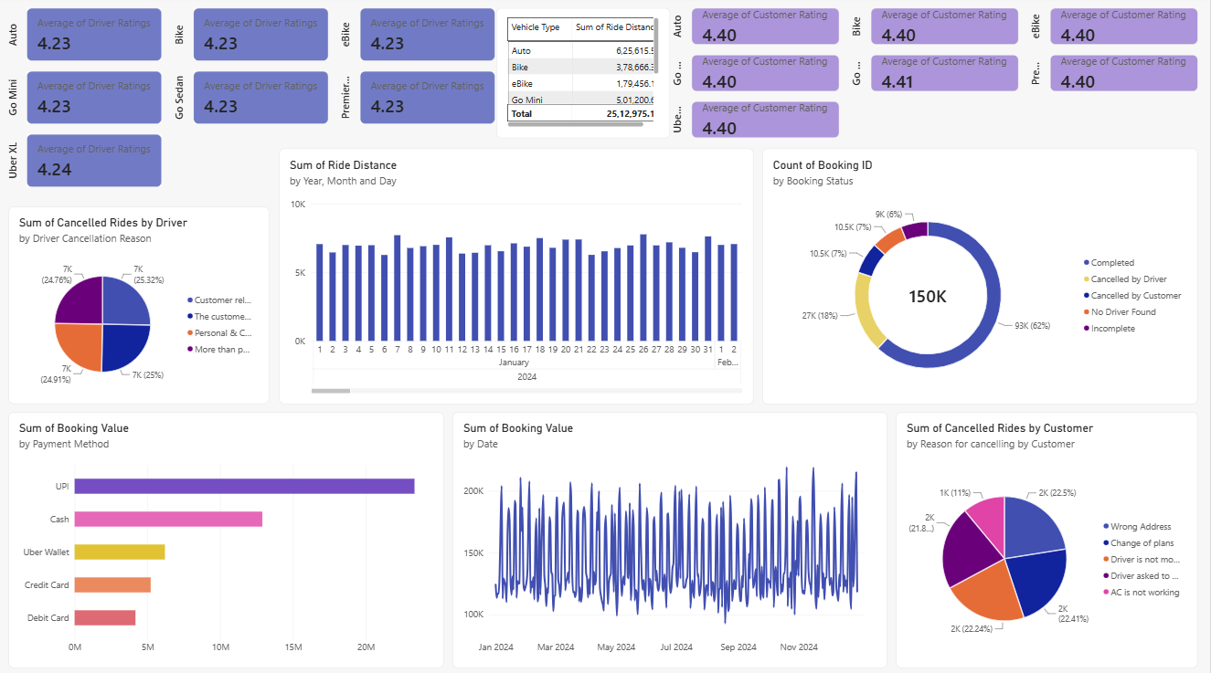
Dashboard Key Insights
Dashboard
INSIGHTS
150K total bookings analyzed across 2024.
62% of bookings were completed, indicating strong overall ride fulfillment.
Average Driver Rating: 4.23/5
Average Customer Rating: 4.40/5
Auto recorded the highest total ride distance among vehicle types.
UPI generated the highest booking value, followed by Cash and Uber Wallet.
Cancellations remain a key challenge, with both driver- and customer-related factors contributing significantly.
Booking value fluctuated throughout 2024, showing noticeable peaks and dips in daily revenue.
Key improvement area: Reduce cancellations and improve ride completion to enhance revenue and customer experience.

Slide 4
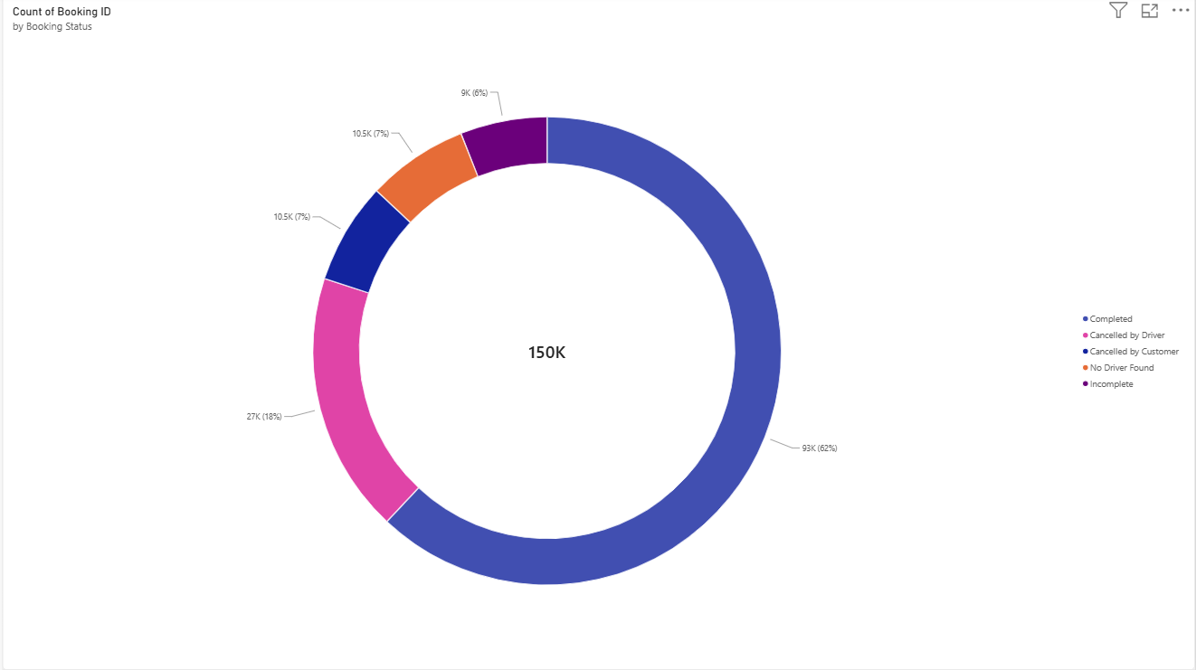
Booking Overview
Key Performance Indicators
150K total bookings were recorded.
Completed rides dominate at 62% (93K), indicating a strong completion rate.
Driver cancellations account for 18% (27K) — the largest source of unsuccessful bookings.
Customer cancellations and no-driver-found cases contribute 7% each (10.5K).
Incomplete rides are lowest at 6% (9K).
Key Insight: While most rides are successfully completed, driver cancellations are the biggest operational concern and offer the clearest opportunity for improvement
Focus: Understand overall business performance.

Slide 5
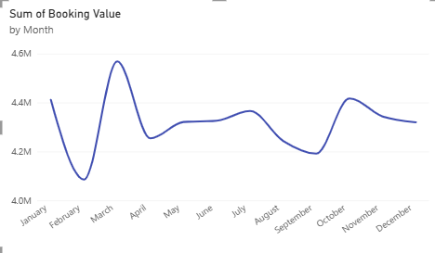
Booking Trends
Booking value peaks in March (~4.57M), indicating the strongest monthly performance.
February records the lowest value (~4.09M).
A recovery occurs in October, followed by a gradual decline toward December.
Overall, booking value fluctuates moderately throughout the year.
Key Insight: Identify the factors driving March’s peak and February’s dip to improve revenue consistency and forecasting.
Insight: Helps understand changing ride demand.

Slide 6
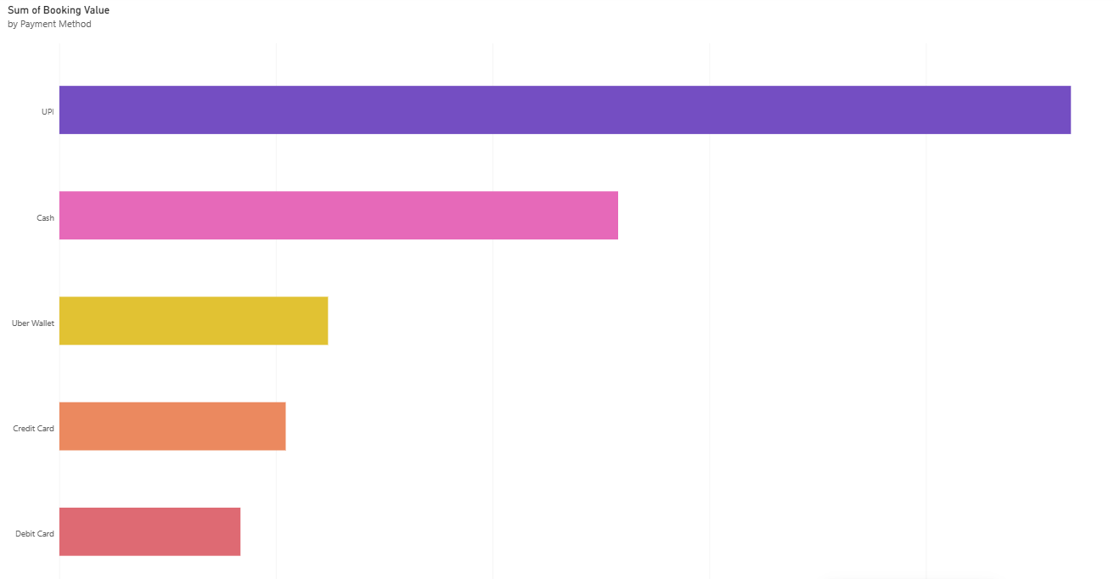
Booking & Payment Analysis
Booking Status & Payment Methods
UPI contributes the highest booking value, making it the dominant payment method.
Cash is the second-highest contributor.
Uber Wallet, Credit Card, and Debit Card contribute comparatively lower values.
Key Insight: The business should prioritize and optimize UPI payments, while maintaining support for other payment options.

Slide 7
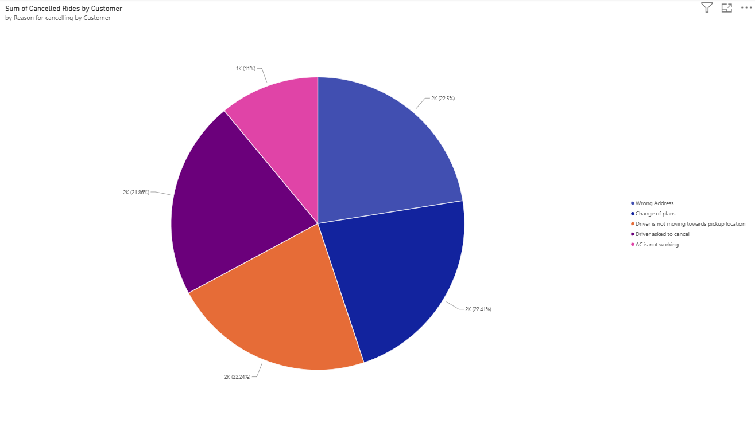
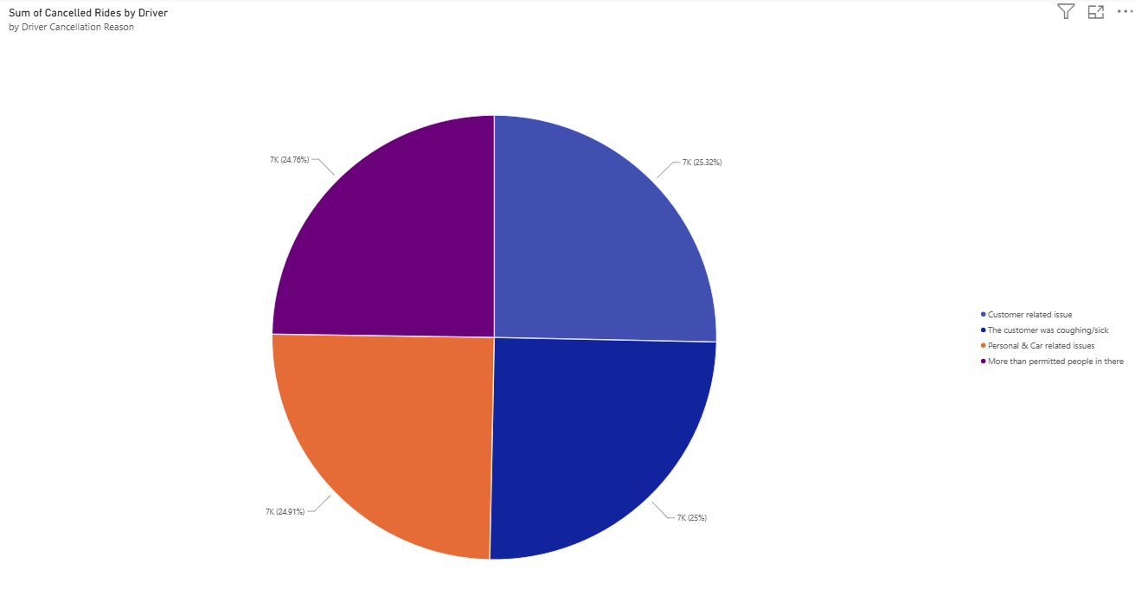
Cancellation Analysis
Customer Cancellation Analysis
Cancellations are fairly evenly distributed across major reasons.
Wrong address (22.5%) is the leading reason.
Change of plans (22.41%) and driver not moving toward pickup (22.24%) follow closely.
AC not working (11%) is the least common reason.
2. Driver Cancellation Analysis
Driver cancellations are almost evenly distributed across all reasons.
Customer-related issues (25.32%) are the highest.
Customer illness (25%) and personal/car issues (24.91%) are close behind.
Excess passengers (24.76%) is also a significant contributor.
Key takeaway: Both charts show that cancellations have multiple contributing factors, so improvement should target several issues rather than one single cause.

Slide 8

Recommendations
Reduce customer & driver cancellations.
Optimize driver allocation during peak hours.
Prioritize high-demand vehicle types.
Improve service quality and driver performance.
Promote preferred payment methods.
Monitor booking trends for better forecasting.
Use ratings to identify service gaps.

Slide 9

Conclusion
Power BI converts ride-booking data into actionable business insights.
Key Takeaways
Booking trends reveal demand patterns
Cancellations highlight improvement areas
Vehicle analysis supports resource optimisation
Ratings help measure service quality

